Slide 1
The Water Cycle and the step-by-step Process
The water cycle Is an amazing process which water circulates between the earth's oceans, atmosphere, and land, involving precipitation as rain and snow, drainage in streams and rivers, and return to the atmosphere by evaporation and transpiration.
This Photo by Unknown Author is licensed under CC BY-SA

Slide 2
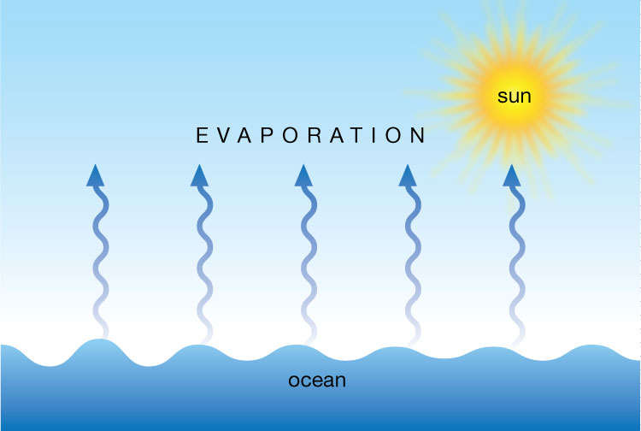
1st Step: Evaporation
Evaporation is when the Sun heats up the water in an Ocean or Lake and brakes the bond between water and water VAPOR .

Slide 3
2nd Step: Condensation
Condensation is when the physical state of matter changes from gas phase into liquid phase. Meaning a gas Condenses into a liquid
This Photo by Unknown Author is licensed under CC BY

Slide 4
3rd Step: Precipitation
Precipitation is when gas turns into a liquid and falls to the ground either in Rain, Snow, Sleet or Hail, the 4 types of precipitation

Slide 5
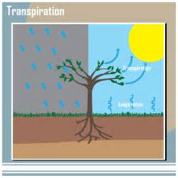
4th Step: transpiration
Transpiration is the process of water movement through a plant and evaporation from parts such as leaves, stems and flowers.

Slide 6
5th Step : Run-Off
Surface runoff (also known as overland flow) is the flow of water that occurs when excess stormwater, meltwater, or other sources flows over the Earth's surface.
This Photo by Unknown Author is licensed under CC BY-SA

Slide 7
And the water cycle starts allll over again!
Thanks for looking at this Power Point and taking the time to understand the Water Cycle!
This Photo by Unknown Author is licensed under CC BY-SA

