Slide 1
Earth’s Awesome Spheres and their Amazing Interactions!
SC.6.E.7.4 Differentiate and show interactions among the geosphere, hydrosphere, cryosphere, atmosphere and biosphere.

Slide 2
What on Earth?
What is the Earth system?
A group of related objects or parts that work together to form a whole. Ex: the planets that make up the solar system.
The Earth system is all of the matter, energy, and processes within Earth’s boundary.
Earth is a complex system full of living and nonliving things and the matter and energy that continuously cycle through the smaller systems.

Slide 3
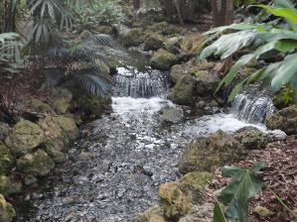
What is the GEOSPHERE?
The geosphere is the mostly solid, rocky part of Earth. It extends from the center of Earth to the surface of Earth.
The crust is the thin, outermost layer of the geosphere.
THE ROCKY, TERRESTRIAL PARTS OF THE EARTH
CAN YOU DIG IT????

Slide 4
What is the Hydrosphere?
The hydrosphere is the part of Earth that is liquid water – H2O
Oceans, lakes, rivers, marshes, and groundwater are part of the hydrosphere.
Water is moving through Earth and even into and out of living things at all times!

Slide 5
What is the cryosphere?
The cryosphere is made up of all of the frozen water on Earth.
Ice, snow, sea ice, glaciers, ice shelves, icebergs, and frozen ground are all part of the cryosphere.
Changes in the cryosphere can play an important role in Earth’s climate.
Ice, ice baby!

Slide 6
What’s the Atmosphere?
The atmosphere is a combination of mostly invisible gases that surrounds Earth.
About 78 % of the atmosphere is nitrogen. Oxygen makes up 21 % of the atmosphere.

Slide 7
What is the biosphere?
The biosphere is made up of all living things.
Organisms usually need oxygen or carbon dioxide to carry out life processes.
Liquid water, moderate temperatures, and a stable source of energy are also required for most living things.

Slide 8
How do Earth’s spheres interact?
All of the five spheres of Earth interact as matter and energy change and cycle through the system.
Matter moves between Earth’s spheres.
Sometimes, matter moves through many spheres before returning to a sphere.
Energy moves between spheres. Energy also moves back and forth between spheres.

Slide 9
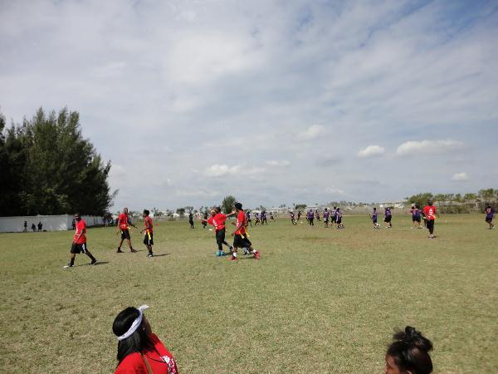
Which of Earth’s spheres are Interacting? Can you explain?
1
1. Atmosphere
2. Biosphere
3. Cryosphere
4. Geosphere
5.Hydrosphere

Slide 10
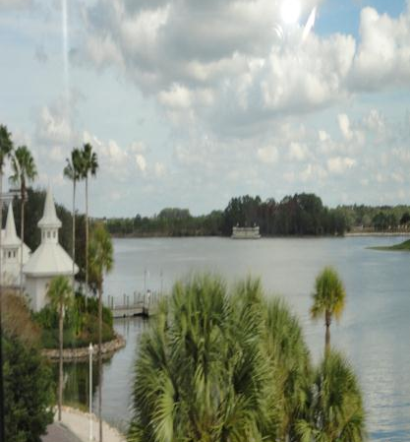
Which of Earth’s spheres are interacting in the picture?
1. Atmosphere
2. Biosphere
3. Cryosphere
4. Geosphere
5.Hydrosphere

Slide 11
Which of Earth’s spheres are interacting in the picture?
1. Atmosphere
2. Biosphere
3. Cryosphere
4. Geosphere
5.Hydrosphere

Slide 12
Which of Earth’s spheres are interacting in the picture?
1. Atmosphere
2. Biosphere
3. Cryosphere
4. Geosphere
5.Hydrosphere

Slide 13
Which of Earth’s spheres are interacting in the picture?
1. Atmosphere
2. Biosphere
3. Cryosphere
4. Geosphere
5.Hydrosphere

